Slide 1
Simple web Tabulation
R.BALASUBRAMANIYAN
STUDENT NAME :
24131041802521007 & asanm10424cs40
RIGISTER NO AND NMID:
JAWAHAR SCIENCE COLLEGE
COLLEGE / UNIVERSITY:
STUDENT NAME : MOHAN RAJ .A
REGISTER NO AND NMID :
DEPARTMENT: B.s.c.Computer science
COLLEGE: COLLEGE/ UNIVERSITY: Annamalai University

Slide 2
Simple web Tabulation
Project Name

Slide 3

PROBLEM STATEMENT
The problem lies in ensuring that web pages are:
1.Visually attractive to capture users’ attention.
2.Responsive across devices (desktop, tablet, mobile).
3.Consistent in design for better user experience.
4.Efficiently maintainable to reduce development time and errors.
Websites and applications must not only provide accurate information but also deliver a visually appealing, consistent, and user-friendly interface. While HTML structures the content, it does not control the design, layout, and responsiveness of a webpage. Without proper styling, web pages appear plain, cluttered, and difficult to navigate, reducing user engagement and accessibility

Slide 4

AGENDA
Problem Statement
Project Overview
End Users
Tools and Technologies
Portfolio design and Layout
Features and Functionality
Results and Screenshots
Conclusion
Github Link
3/21/2024 Annual Review

Slide 5

PROJECT OVERVIEW:
The Tabulation Program with CSS is a simple web-based project designed to display structured data in a tabular format with enhanced styling. While HTML provides the structure of the table, CSS adds visual appeal and readability by applying styles such as borders, colors, alignment, spacing, and hover effects. This makes the table more professional and user-friendly

Slide 6
WHO ARE THE END USERS?
StudentsTo view their marks, results, or performance in a clear and visually appealing format.Helps them easily understand and compare data.
Teachers / FacultyTo prepare and present student results in a structured way.Makes the report look professional and easy to read.
School / College AdministrationTo maintain student records digitally.To create well-designed reports for official use
Parents (Indirect Users)To check their child’s progress in an easy-to-read tabulated format.
Web Developers / LearnersTo learn and practice CSS styling techniques for improving the presentation of tables.

Slide 7

TOOLS AND TECHNIQUES
Tools Used:
HTML5To create the basic structure of the tabulation (table, rows, columns, headings).Elements used: <table>, <tr>, <th>, <td>, <caption>.
CSS3To style and enhance the appearance of the tabulated data.Applied to add borders, colors, hover effects, alignment, and spacing.
Code Editor (any of the following)Visual Studio Code / Sublime Text / Notepad++ → for writing HTML & CSS code.
Web Browser (Google Chrome, Firefox, Edge, etc.)
Techniques Used:
Table StylingUsed border-collapse, border, and padding to make the table neat.
Text FormattingCSS properties like font-family, text-align, and font-size were applied for readability.

Slide 8
POTFOLIO DESIGN AND LAYOUT
● Portfolio Design and Layout A portfolio is a collection of personal, academic, or professional work that highlights an individual’s skills, achievements, and projects. The design and layout play a key role in making the portfolio attractive, structured, and user-friendly.
Design
1. Simplicity → Clean and minimal design to avoid clutter.
2. Consistency → Same font style, colors, and spacing throughout the portfolio.
3. Readability → Proper headings, subheadings, and white spaces for easy reading.
4. Visual Balance → Using images, icons, and graphics without overpowering text
5. Responsiveness → Layout adapts to all devices (mobile, tablet, desktop).
8

Slide 9
Layout Sections: A well-structured portfolio usually contains: Header SectionYour Name / LogoA short tagline or title (e.g “Web Developer Designer Programmer”)Navigation menu (Home, About, Projects, Contact) About Me SectionA short introduction with your background, skills, and goalsProfile picture for personal branding Skills SectionList of technical skills (e.g C++, HTML, CSS, JavaScript) Projects SectionShowcase your best projects with title, description, screenshots, and link

Slide 10
FEATURES AND FUNCTIONALITY
Features :
Separation of Content and DesignHTML handles content, CSS handles styling (colors, fonts, layout).
Styling Capabilities
Functionality :
Visual PresentationControls how web pages look (color schemes, typography, layouts).
User Experience (UX) EnhancementImproves readability, navigation, and overall interaction with animations & hover effects.
Responsive Web DesignEnsures websites adapt automatically to different screen sizes and devices.

Slide 11
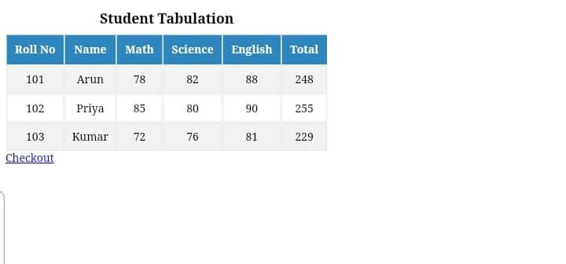

RESULTS AND SCREENSHOTS
3/21/2024 Annual Review
11

Slide 12
CONCLUSION
HTML, CSS, and JavaScript together form the foundation of modern web development.HTML provides the structure and content of a web page.CSS enhances the design, style, and layout, making the interface visually appealing and responsive.JavaScript adds interactivity, logic, and dynamic functionality, improving user engagement and experience.
12

